Slide 1

Title
Math Puzzle Solving Compiler which Parses and solves mathematical puzzles with step-by-step explanations
Supervisor Research Scholar
Dr.M.ARULRAJ B.BHARGAVI
Professor 192311136
Saveetha School of Engineering Saveetha School of Engineering

Slide 2
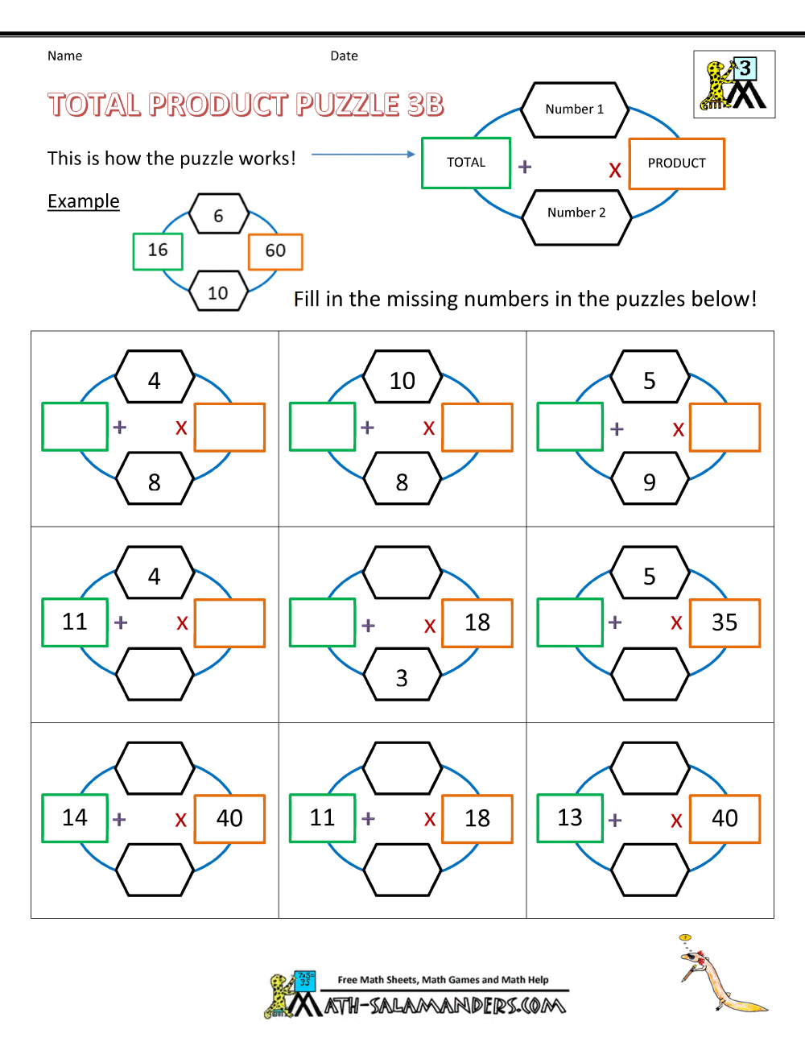
Introduction
The Math Puzzle Solving Compiler is designed to analyze and solve mathematical puzzles efficiently.
It provides step-by-step explanations to enhance understanding and learning.
This tool is beneficial for students, educators, and Puzzle solvers .

Slide 3
IMPORTANCE
Error Reduction – Minimizes human calculation mistakes by providing accurate solutions.
Time Efficiency – Quickly solves puzzles, saving time compared to manual calculations.
Concept Clarity – Provides step-by-step explanations, reinforcing mathematical reasoning and logic.
Versatile Applications – Useful for education, competitive exams, and AI-driven tutoring systems.

Slide 4
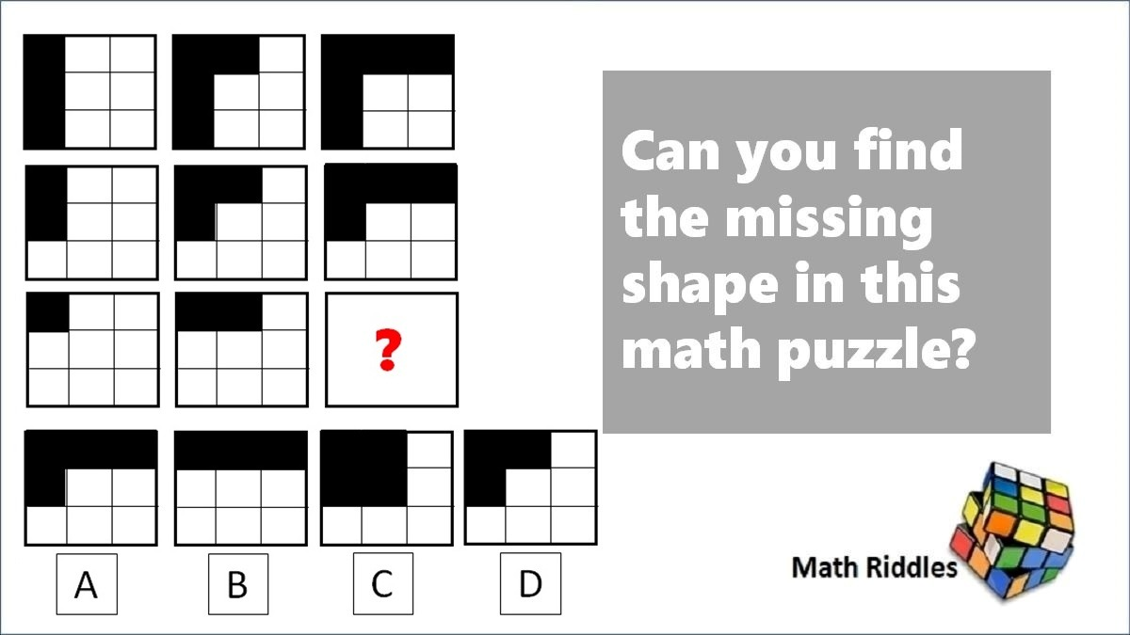
Proposed Aim
The main aim of a Math Puzzle Solver is to analyze, parse, and solve mathematical puzzles while providing a step-by-step explanation to enhance understanding, accuracy, and efficiency in problem-solving.
The main purpose of the compiler is to simplify complex mathematical puzzles.
It aims to provide clear solutions that can be easily followed by users.

Slide 5
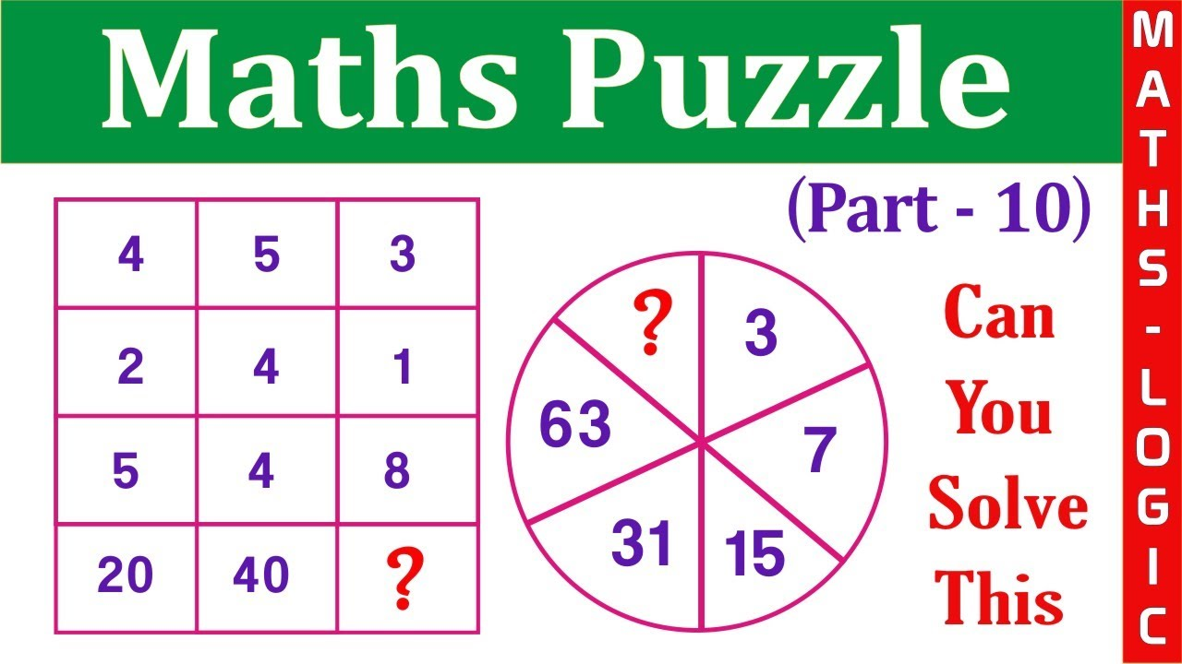
Proposed Objectives
Puzzle Parsing & Understanding
Analyze and interpret different mathematical puzzle formats.
Support algebraic, arithmetic, logical
word-based puzzles.
Use NLP for processing text-based problems.

Slide 6

User Interface Overview
The user interface is designed to be user-friendly and accessible to all skill levels.
It includes input fields for entering puzzles and output sections for displaying solutions.
Visual aids and interactive elements enhance the overall user experience.

Slide 7
Step-by-Step Solution Process
Each solution is accompanied by a detailed, step-by-step breakdown.
This process helps users understand the reasoning behind each step taken.
Clear explanations promote better retention of mathematical concepts.

Slide 8
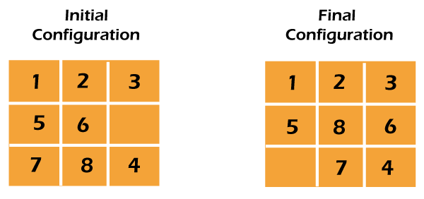
Implementation and Technology Stack
The compiler is built using a combination of programming languages and libraries.
Technologies like Python and JavaScript enable robust functionality and interactivity.
A strong backend ensures efficient processing and handling of complex calculations.

Slide 9
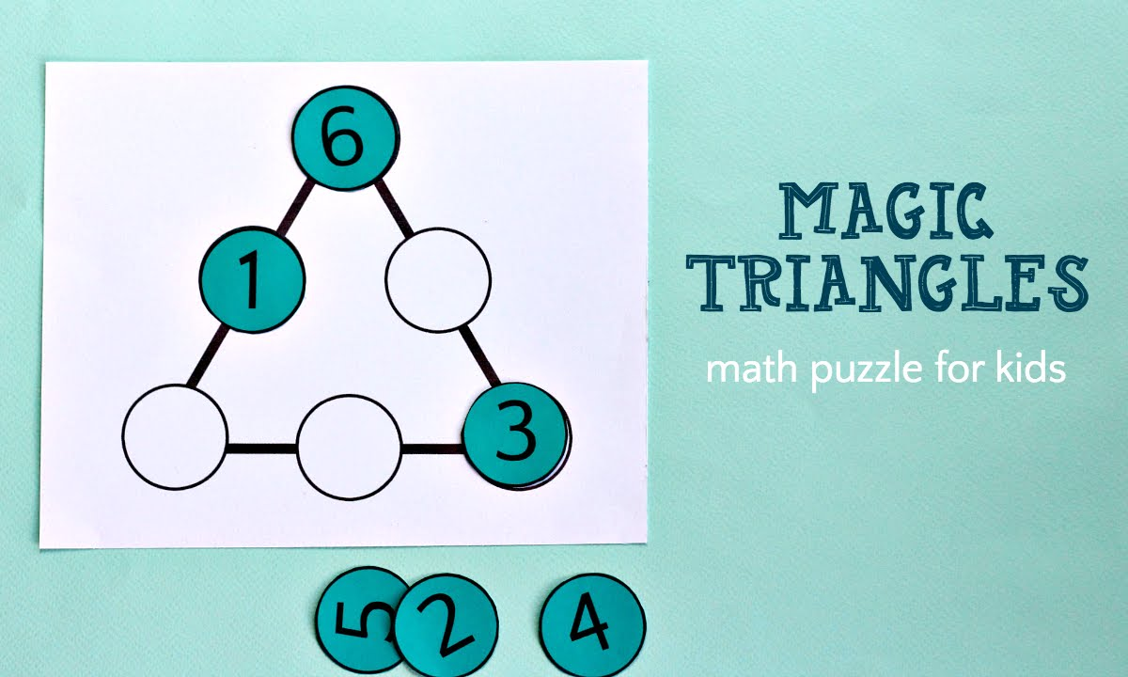
Challenges Faced in Development
Developing an effective parser for diverse mathematical expressions was challenging.
Ensuring the accuracy of solutions while providing educational explanations required careful planning.
Balancing user experience with the complexity of mathematical concepts was essential.

Slide 10
Future Enhancements
Future versions may include support for additional languages and more complex puzzle types.
Enhancements could involve integrating machine learning for adaptive learning experiences.
User feedback will play a crucial role in shaping future updates and features.

Slide 11
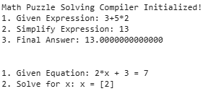
OUTPUT:

Slide 12
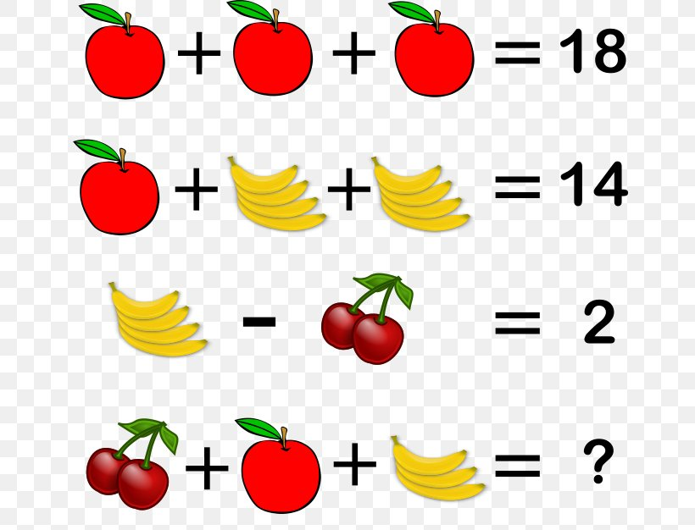
Conclusion
The Math Puzzle Solving Compiler is a powerful tool for solving and understanding mathematical puzzles.
Provides a step-by-step learning approach for users.
Enhances engagement, accuracy, and mathematical understanding.

Slide 13
References
1)Hosseinpour, S., Alavi Milani, M. M. R., & Pehlivan, H. (2018). A step-by-step solution methodology for mathematical expressions. Symmetry, 10(7), 285.
2)Lioubartsev, D. (2016). Constructing a Computer Algebra System Capable of Generating Pedagogical Step-by-Step Solutions.
3)D'Ambrosia, B., Kirschenbaum, M., Palmer, D., Schneider, L., Seiter, L., Bollman, M., ... & Wilmer, E. (2007). MCURCSM 2007 Midstates Conference for Undergraduate Research in Computer Science and Mathematics.
4)Zhang, D., Wang, L., Zhang, L., Dai, B. T., & Shen, H. T. (2019). The gap of semantic parsing: A survey on automatic math word problem solvers. IEEE transactions on pattern analysis and machine intelligence, 42(9), 2287-2305.
5)Lehnfeld, M. (2014). Introducing Parallelism in an Educational Mathematics System Developed in a Functional Programming Language.

